Slide 1
DEMERITS OF GLOBALIZATION
Demerits
AISHWARYA SINGH (66)
BHAKTI CHOKSY (55)
APURVA GADRE (78)
SNEHA MALAKNAWAR (61)
AMRITA TAWADE (68)
Environmental
Economical
Cultural
Intro
Thank you
Smt Maniben M.P.Shah Women's College of Arts and Commerce/FC

Slide 2
Cultural
Demerits
Intro
Thank you
Economical
Environmental
GLOBALIZATION
What Is Globalization ?
Globalization or globalization is the process of interaction and integration between people, companies, and governments worldwide. Globalization has grown due to advances in transportation and communication technology. With increased global interactions comes the growth of international trade, ideas, and culture
Smt Maniben M.P.Shah Women's College of Arts and Commerce/FC

Slide 3
Economical
ECONOMICAL
ENVOIRNMENTAL
CULTURAL
Demerits
Cultural
Intro
Environmental
Thank you
Smt Maniben M.P.Shah Women's College of Arts and Commerce/FC

Slide 4
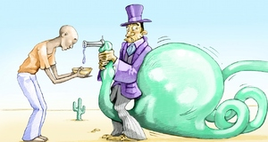
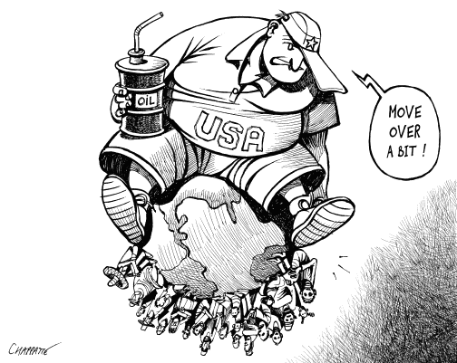
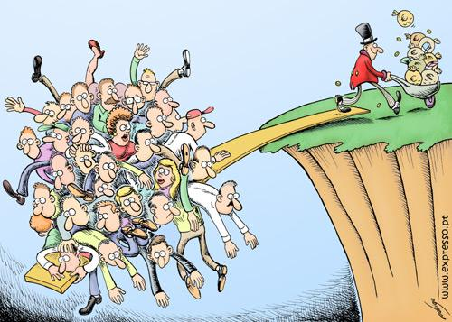
Gap between the rich and the poor.
Downfall of one major economic nations adversely affects entire global economy.
Less developed countries have become dependent upon superior nations.
Specialization of labor.
Local industries could not compete with their global counterpart.
Cultural
Demerits
Thank You
about
Environmental
Economical
Smt Maniben M.P.Shah Women's College of Arts and Commerce/FC

Slide 5
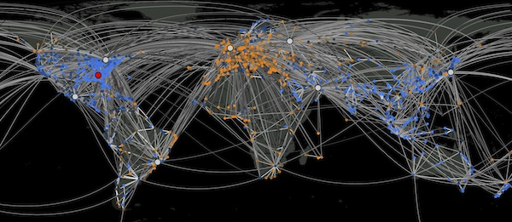
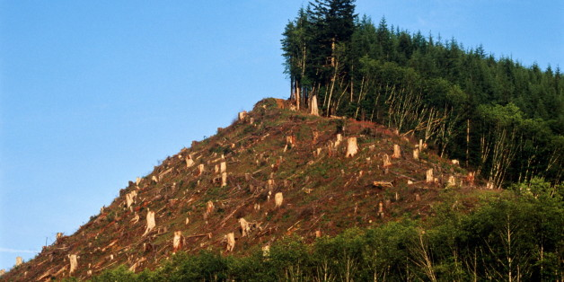
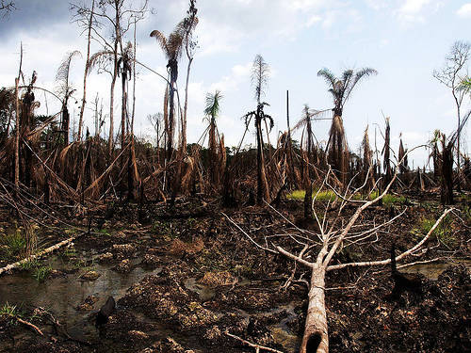
Spread of diseases from one country to another country.
Forests have been cut, environmental degradation.
Thank You
Demerits
Cultural
Economic
Intro
Environmental
Smt Maniben M.P.Shah Women's College of Arts and Commerce/FC

Slide 6
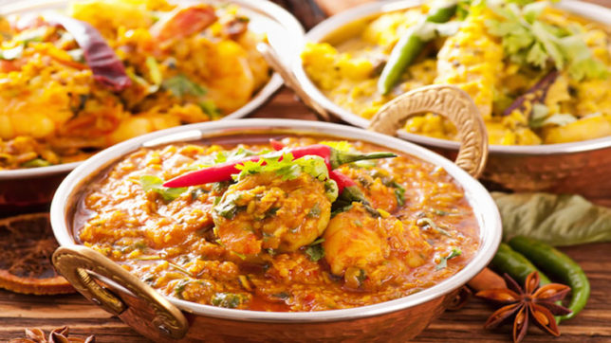
Fail to preserve their old traditions , customs and culture.
Globalization can pressure us to act in a certain way.
Environmental
Thank You
Cultural
Demertis
Intro
Economical
Smt Maniben M.P.Shah Women's College of Arts and Commerce/FC

Slide 7
Thank You
Demerits
Environmental
Cultural
Intro
Economical

