Slide 1
PATIENTS RIGHTS
BY USMA & GROUP
Smt Maniben M.P.Shah Women's College of Arts and Commerce/FC

Slide 2
THE RIGHTS
Right to emergency medical care
Right to information – doctor’s experience, the nature, cause and likely outcome of illness, care, results, risks/advantages of alternative procedures, treatment options.
Right to dignity
Right to privacy/confidentiality
Right to non-discrimination on the basis of HIV status
Right to choose alternative treatment
Right to seek second option
Right to informed consent
Right to make suggestions and complaints.
Right to seek redressal.
Smt Maniben M.P.Shah Women's College of Arts and Commerce/FC

Slide 3
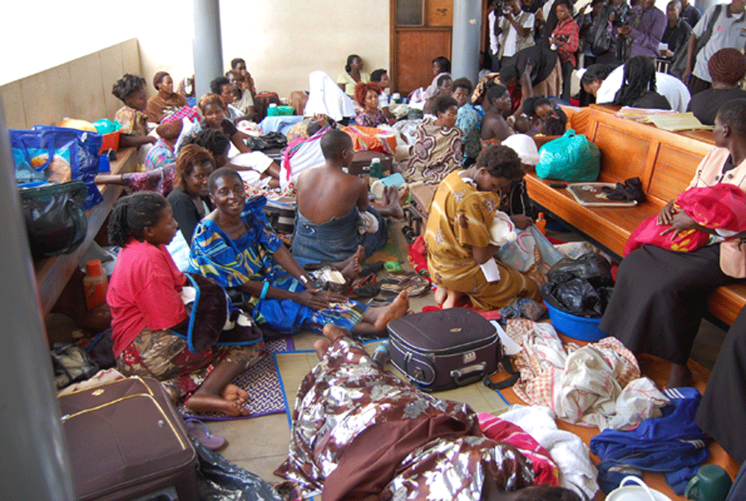
CHARTER OF PATIENTS RIGHT
Right to access health care.
Right to Information.
Right to Quality Care.
Right to autonomy and decision making .
Right to privacy
Smt Maniben M.P.Shah Women's College of Arts and Commerce/FC

Slide 4
RIGHTS OF THE PATIENT
Right to considerate and respectful care.
Right to information on diagnosis, treatment and medicines.
Right to obtain all the relevant information about the professionals involved in the patient care.
Right to expect that all the communications and records pertaining to his/her case be treated as confidential.
Right to every consideration of his/her privacy concerning his/her medical care programme.
Smt Maniben M.P.Shah Women's College of Arts and Commerce/FC

Slide 5
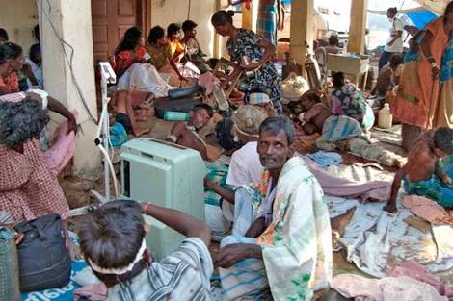
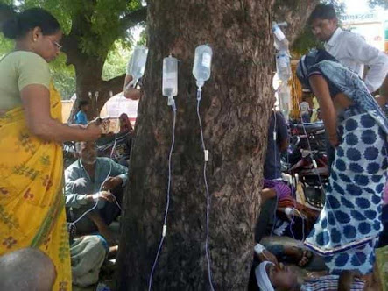
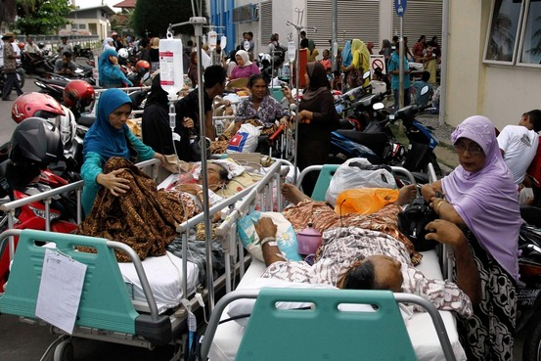
Smt Maniben M.P.Shah Women's College of Arts and Commerce/FC

