Slide 1
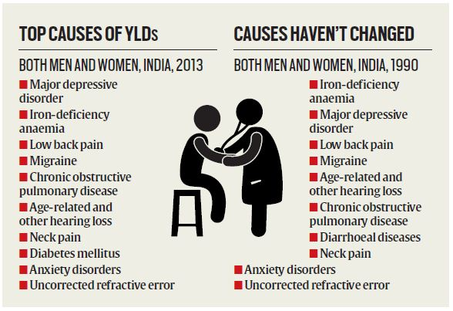
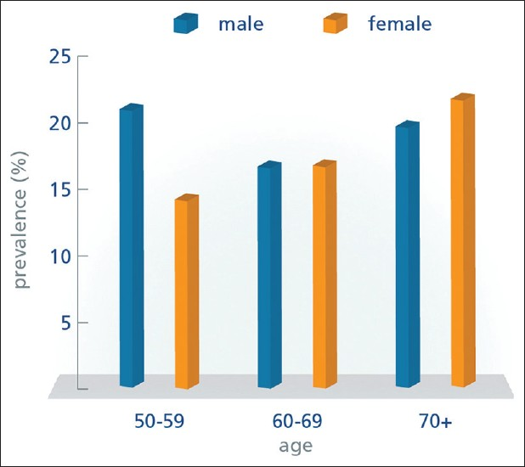
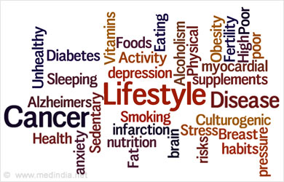
Women’s related disease in India
Smt Maniben M.P.Shah Women's College of Arts and Commerce/FC

Slide 2
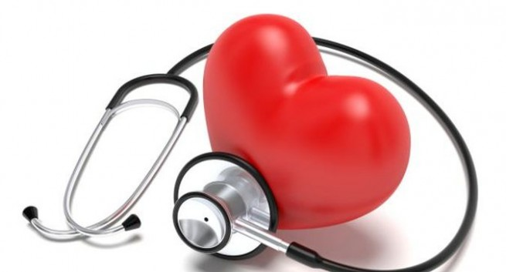
Group member’s Name & roll no.
Juveria 92 Saba 132 Nazma 131 Rajeshwari 108 Yelina 112 Rukhsar 95 Sarsawati 116 Kajol 114 Zarina 103
Smt Maniben M.P.Shah Women's College of Arts and Commerce/FC

Slide 3
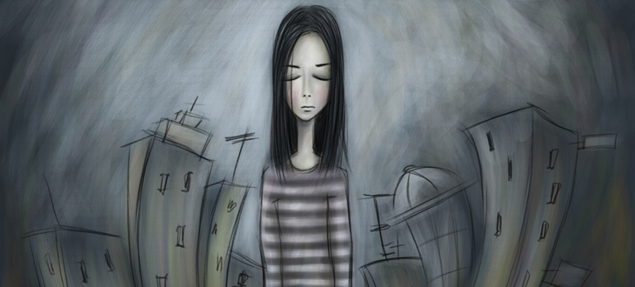
Women's related diseases in India
The surveys reveals that 42% of working women suffers from lifestyle diseases.
Multitasking women neglecting their health as well as their health linked with their status in society
Smt Maniben M.P.Shah Women's College of Arts and Commerce/FC

Slide 4
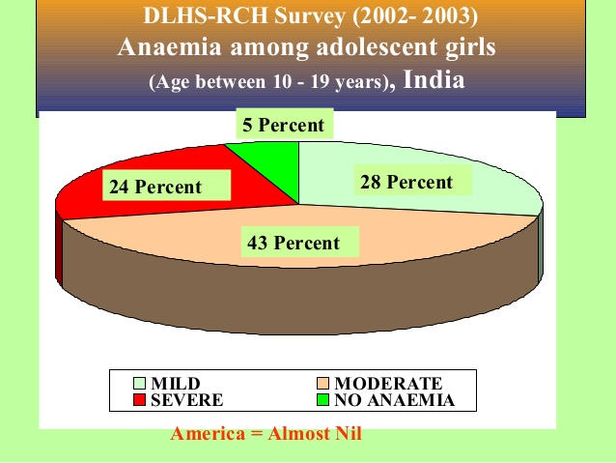
Malnutrition
Nutrition plays a major role in an individual’s overall health psychological and physical health status
India currently has one of highest rates of malnutrition women among developing countries like India
A study in 2005 found that 70% of non pregnant women and 75% of pregnant women were anaemic in term of iron deficiency .
However the rate of malnutrition increases in married women compared to non married women.
Smt Maniben M.P.Shah Women's College of Arts and Commerce/FC

Slide 5
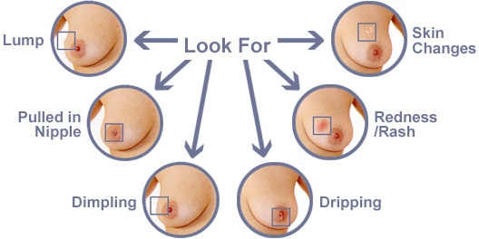
Breast cancer
Breast cancer is fast becoming a wide spread phenomenon among women in India
Breast cancer has ranked no.1 in Indian female.
According to the WHO of the cases diagnosed in 2012,25% Of the all over in women were breast cancer.
The national cancer registry programme lists that 20%of all breast cancer cases in India occur among below the age of 40.
1% of deaths worldwide occurring due to the breast cancer
Smt Maniben M.P.Shah Women's College of Arts and Commerce/FC

Slide 6
Osteoporosis
The prevalence of osteoporosis,ostoarthirist backache are the common problem among elderly women in India ideally prevalent in India and is a common case low calcium diet and lack of health awareness are two major causes behind this health problem.
Smt Maniben M.P.Shah Women's College of Arts and Commerce/FC

Slide 7
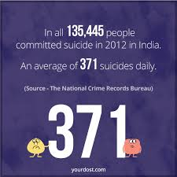
Depression
According to the WHO depression is the most common illness world wide and leading cause of disability
They estimate that 350 million people are affected by depression globally.
Indian women suffers from depression at higher rate then men in India.
Smt Maniben M.P.Shah Women's College of Arts and Commerce/FC

Slide 8
Depression
Smt Maniben M.P.Shah Women's College of Arts and Commerce/FC

Slide 9
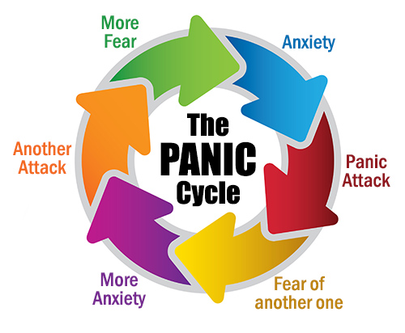
Panic attack
Panic Attack Symptoms
Panic attacks involve sudden feelings of terror that strike without warning
people with panic attacks experience several of the following symptoms:
"Racing" heart
Feeling weak, faint, or dizzy
Tingling or numbness in the hands and fingers
Sense of terror, or impending doom or death
Feeling sweaty or having chills
Chest pains
Breathing difficulties
Feeling a loss of control
Smt Maniben M.P.Shah Women's College of Arts and Commerce/FC

Slide 10
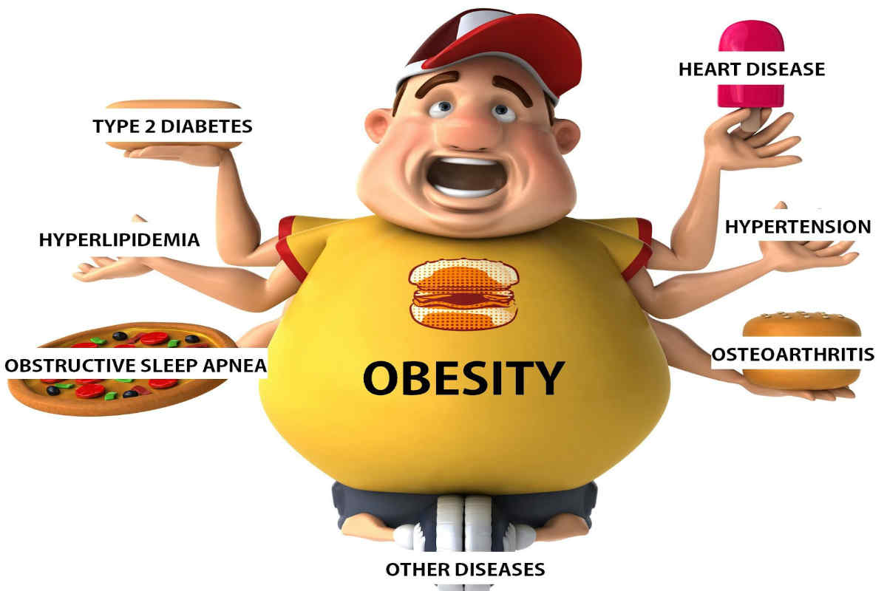
Obesity
Obesity is another health concern topping the list of women in twenties.
In urban India more than 23% women are overweight or obese.
Smt Maniben M.P.Shah Women's College of Arts and Commerce/FC

Slide 11
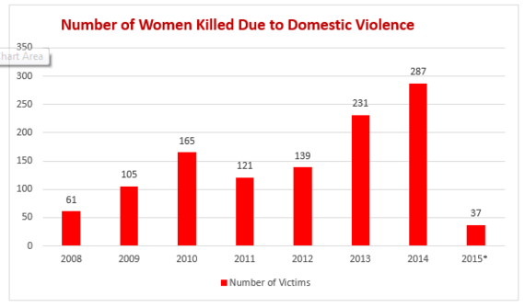
Domestic violence
It is major problem in India domestic violence acts of physical psychological and sexual violence against women.
Women is found across the world’s currently viewed as a hidden epidemic by the world health organisation.
Smt Maniben M.P.Shah Women's College of Arts and Commerce/FC

Slide 12
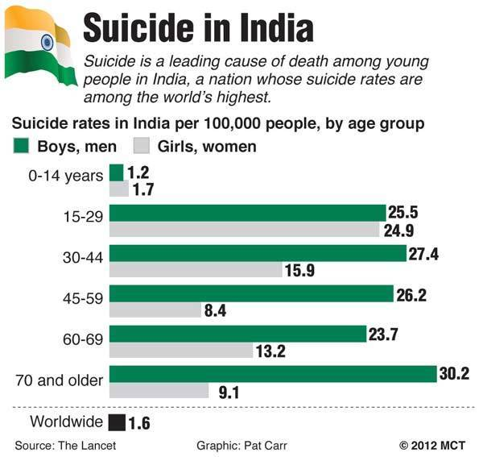
Suicide
Suicide Indian women have higher rates of suicide then women of most developed countries.
The common reason seated for Women's Suicide are directly related to depresstion,anxiety,gender discrimination.
disadvantage and domestic violence.
The suicide rate particularly high among female sex workers in India who face numerous of discrimination for them gender and line of work .
Smt Maniben M.P.Shah Women's College of Arts and Commerce/FC

Slide 13
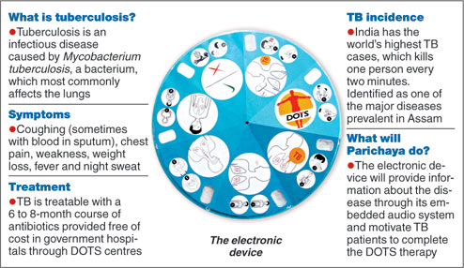
Tuberculosis in India
India is the highest TB burden country with World Health Organisation (WHO) statistics for 2011 giving an estimated incidence figure of 2.2 million cases of TB for India out of a global incidence of 9.6 million cases Common symptoms include:
coughing that lasts longer than 3 weeks with green, yellow, or bloody sputum
weight loss
fatigue
fever
night sweats
chills
chest pain
shortness of breath
loss of appetite
Smt Maniben M.P.Shah Women's College of Arts and Commerce/FC

Slide 14
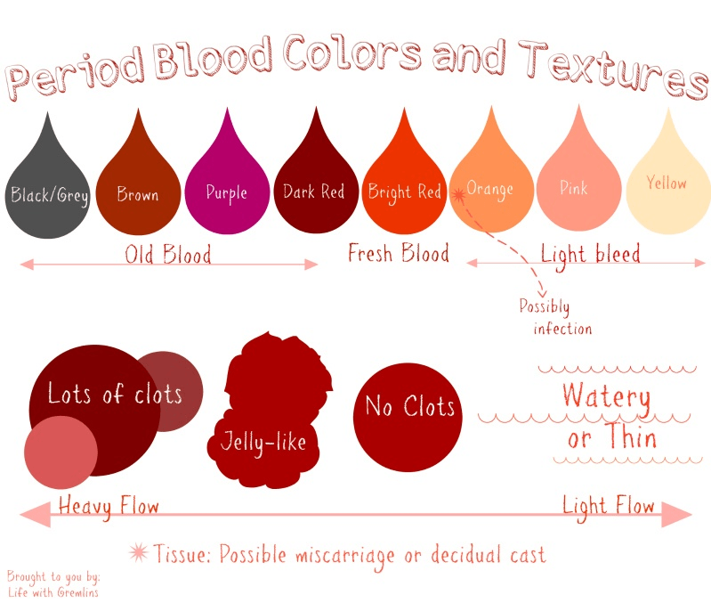
Problems during periods
Smt Maniben M.P.Shah Women's College of Arts and Commerce/FC

Slide 15
Smt Maniben M.P.Shah Women's College of Arts and Commerce/FC

