Slide 1
ZAIBA & SADIKA GROUP
NAME OF THE GROUP MEMBERS
SADIKA 101
ZAIBA 63
SANA 96
NAMEERA 58
FARHEEN 89
NASREEN 129
MUSKAN 127
KEHKASHA 124
NAZMA 130
Smt Maniben M.P.Shah Women's College of Arts and Commerce/FC

Slide 2
ADVANTAGES OF GLOBALIZATION
EDUCATION
INCREASE IN EMPLOYMENT OPPORTUNITIES
REDUCTION IN CULTURAL BARRIERS
INCREAS IN QUALITY GOODS AND SERVICES
FASHION
LANGUAGE
Smt Maniben M.P.Shah Women's College of Arts and Commerce/FC

Slide 3
MEANING OF GLOBALIZATION
Globalization is the process of world wide integration of economic, financial, cultural, environmental and communication system.
Due to globalization, all the countries of the world become inter-dependent and interconnected on each other.
Globalization involves many countries and majority of huge enterprises.
Smt Maniben M.P.Shah Women's College of Arts and Commerce/FC

Slide 4
DEFINATION OF GLOBALIZATION
Globalization is the free movement of people ,good, and services across boundaries. This movement is managed in a unified and integrated manner. Further, it can be seen as a scheme to open the global economy as well as the associated growth in trade (global).
The wake of globalization was first felt in the 1990s in india.
Smt Maniben M.P.Shah Women's College of Arts and Commerce/FC

Slide 5
ADVANTAGES OF GLOBALIZATION
EDUCATION:
Developing skills of co-operation, share responsibility, critical thinking , communication.
Smt Maniben M.P.Shah Women's College of Arts and Commerce/FC

Slide 6
Smt Maniben M.P.Shah Women's College of Arts and Commerce/FC

Slide 7
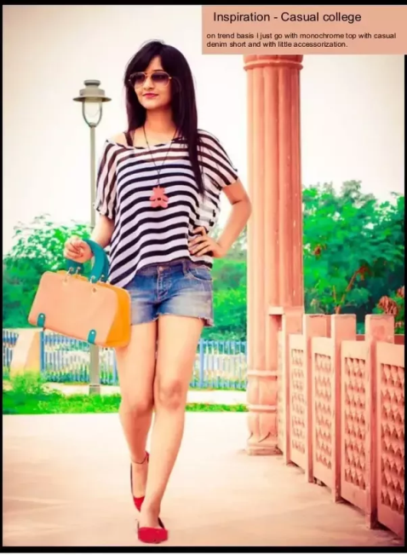
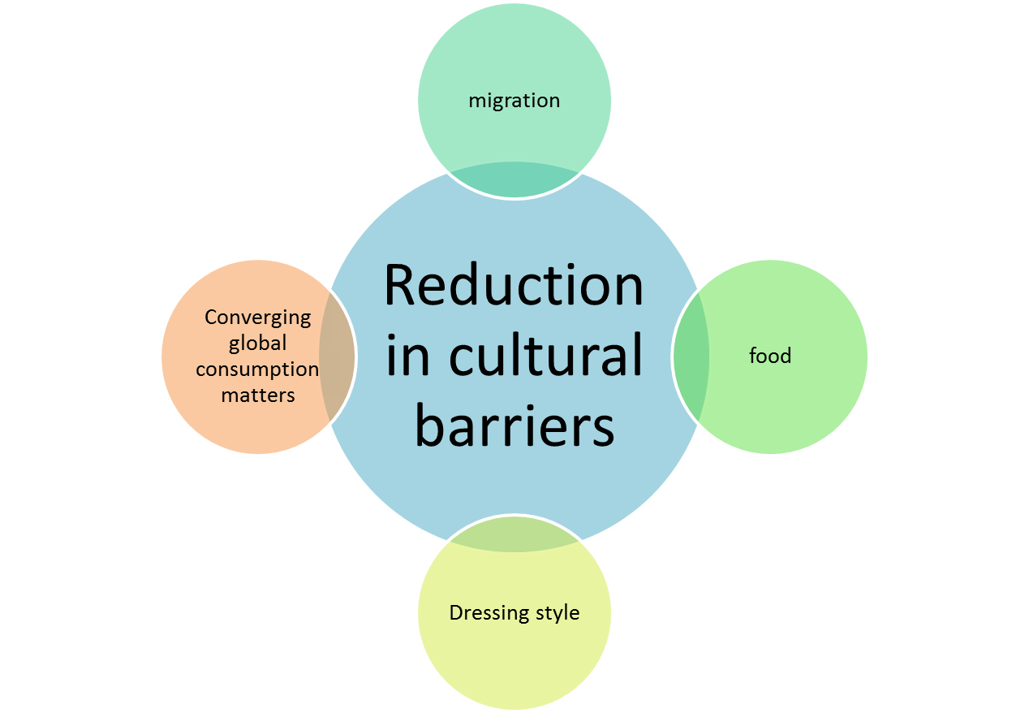
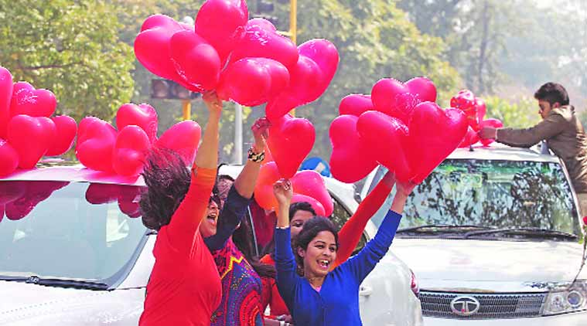
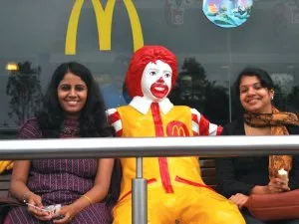
CULTURAL GLOBALIZATION: The rapid movement of ideas, attitudes, meanings, values and cultural products across national borders.
Smt Maniben M.P.Shah Women's College of Arts and Commerce/FC

Slide 8
INCREAS IN QUALITY OF GOODS AND SERVICES
Increase competitiveness make companies more cost and quality conscious.
increase consumer choice.
Trade
Labor
force
Marketing
Advertising products
Smt Maniben M.P.Shah Women's College of Arts and Commerce/FC

Slide 9
INCREASE IN EMPLOYMENT OPPORTUNITIES:
INDUSTRIAL REVOLUTION
EMIGRATION / IMIGRATION
Smt Maniben M.P.Shah Women's College of Arts and Commerce/FC

Slide 10
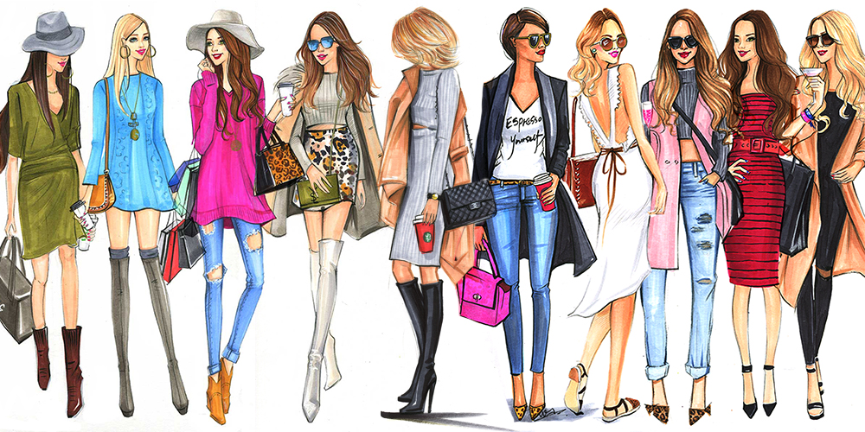
FASHION: A popular or the latest style of clothing , hair, decoration , behavior “ the latest fashion.
Fashion is a multi-billion dollar industry that has to survive in a more and competitive global market and produce for a trans continental audience.
Smt Maniben M.P.Shah Women's College of Arts and Commerce/FC

